Slide 1


PRESENTATION FROM
Debonair Group

Slide 2
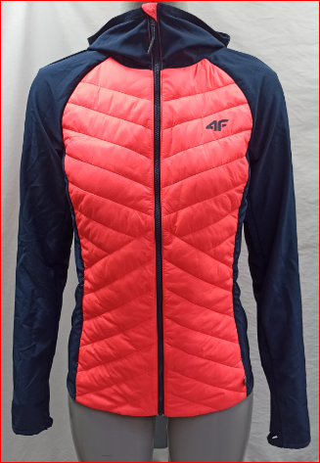
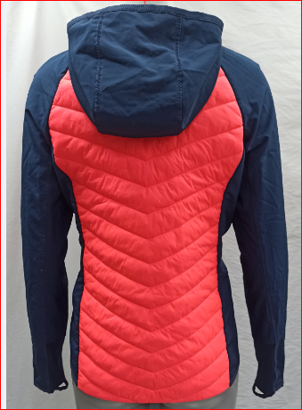
BUYER: OTCF
STYLE NAME: H4Z21-KUDH060
FABRIC COMPOSITION:100% Polyamide & 90% poly/10 nylon fabric
Item Desc : LW Primaloft fake downlight weight jacket with packable

Slide 3
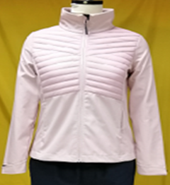
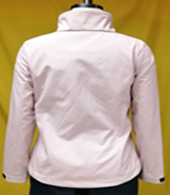
Buyer : OTCF
Style: D4Z19-SFD302 (Women Soft Shell Jacket)
Shell: Body-1: 100 % Polyester Woven Fabric Bonded With 100% Polyester Interlock, Membrane: TPU Lamination Wp 8000/ MVP 6000, DWR Finishing , Body-2:100% Polyamide Full Dull 20D*20D 380T (Matt & DWR Finishing)
Tricot: 100% Polyester Tricot

Slide 4
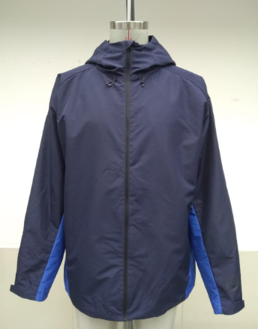
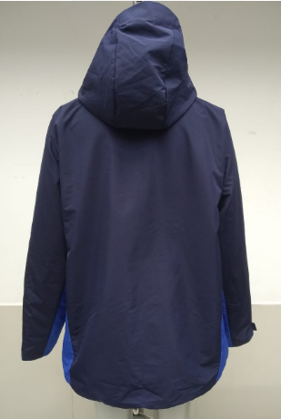
BUYER: GEORGE
STYLE NAME: MENS FAUX TECH JACKET
Men's Jacket
FABRIC COMPOSITION: 100% Polyester

Slide 5
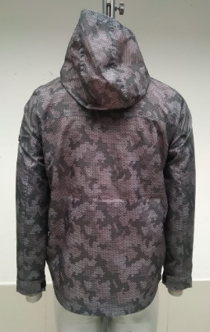
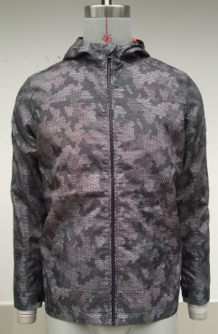
BUYER: GEORGE
STYLE NAME: BOYS DIGI CAMO JACKET
Men's Jacket
FABRIC COMPOSITION: 100% Polyester (AOP)

Slide 6
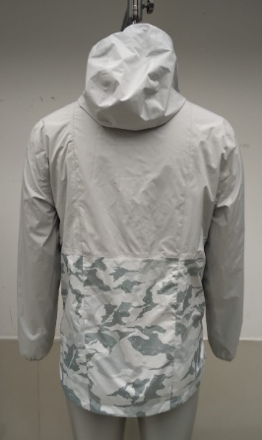
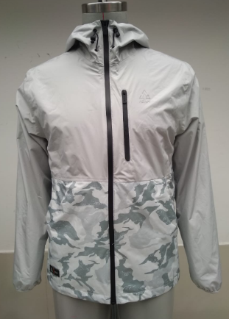
BUYER: GEORGE
STYLE NAME: MENS ADAPED PACKABLE JACKET
Men's Jacket
FABRIC COMPOSITION: 100% Polyester

Slide 7
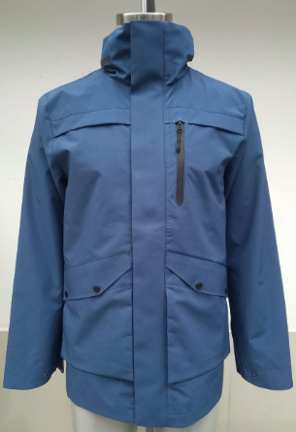
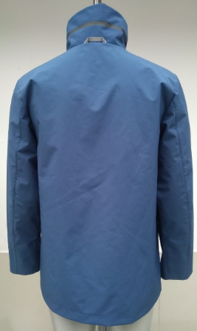
BUYER: GEORGE
STYLE NAME: MENS LW ZIP NON HOOD JACKET
Men's Jacket
FABRIC COMPOSITION: 100% Polyester

Slide 8
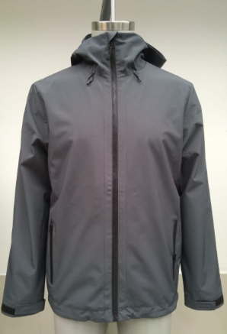
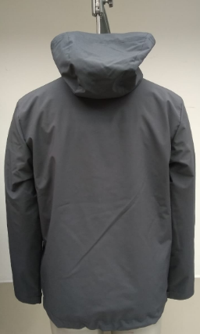
BUYER: GEORGE
STYLE NAME: MENS LW ZIP HOOD JACKET
Men's Jacket
FABRIC COMPOSITION: 100% Polyester

Slide 9
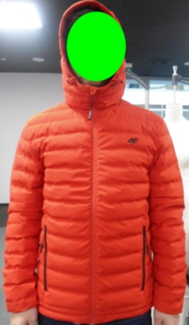
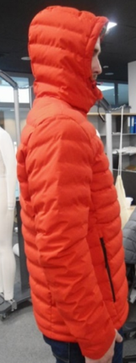
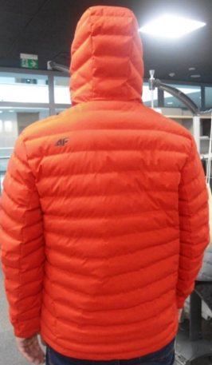
Buyer : OTCF
Style Name : Men’s LW Welded puffer Zip Hooded Jacket
FABRIC COMPOSITION: 100% Polyester welded fabirc

Slide 10
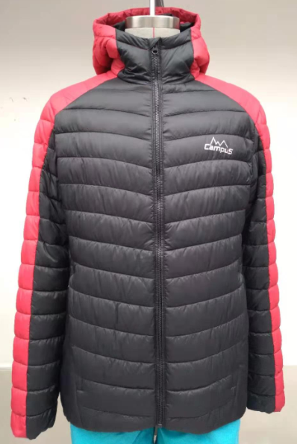
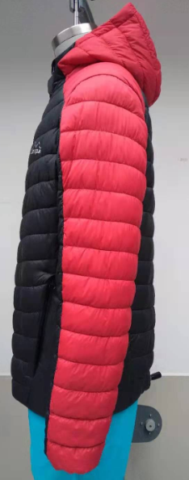
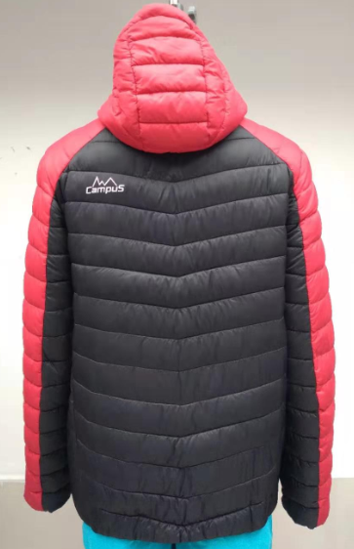
BUYER: Campus
Style Name : Men’s LW puff zip Hooded Jacket
Men's Jacket
FABRIC COMPOSITION: 100% Polyamide 380T

Slide 11
THANK YOU

